Slide 1

WHY
CEO IS
IMPORTANT ?

Slide 2

WHAT IS WT CEO ?

Slide 3
HERE WE GO……….
PLACE WHERE PROSPECT GET TO KNOW ABOUT THE BUSINESS PLAN CLEARLY
UNDERSTAND THE OPPORTUNITY WELL
GET TO KNOW ABOUT THE WINNING TEAM EDUCATION SYSTEM
WHERE YOU ARE ABLE TO SHOW YOUR VALUE TO THE PROSPECT
ASLO YOU CAN SHOW HOW GREAT THE UPLINE IS
CEO IS THE SHOW CASE OF SUCCESS
PROSPECT RELATE WITH THE THEIR PROFESSION
FAITH GET TRANSFERRED EACHOTHER
ENERGY GETS EXCHANGED EACHOTHER

Slide 4
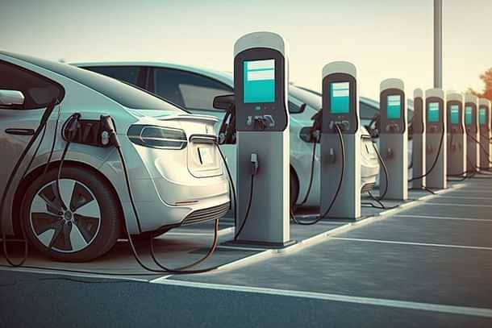

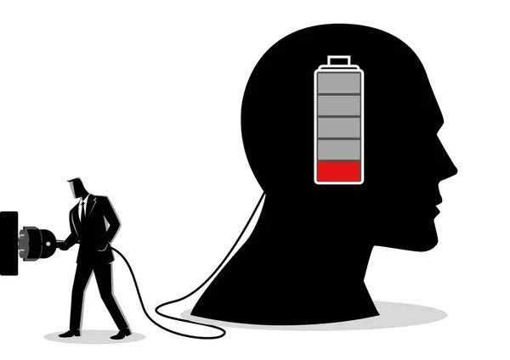
CHARGING STATION FOR THE DISTRIBUTORS
EVEN HUMAN BRAIN NEEDS CHARGING
HAVING THE POSITIVE AURA SURROUNDED WITH LIKE MINDED PEOPLE
BECAUSE WE WORK IN NEGATIVE ENVIRONMENT THE WHOLE WEEK

Slide 5
CONSISTENCY LEADS TO RESULTS
MAKE THE CEO AS THE SECOND EXPOTURE
TAKE THE 21WEEKS CHALLENGE TO ATTEND THE CEO
A PERSON HAS 6000-60,000 THOUGHTS PER DAY (HOW MANY OF THEM ARE NEGATIVE)
IF YOU ARE OUT OF THE SYSTEM, YOU ARE OUT OF THE BUSINESS
DUPLICATE THE SAME IN TEAM
IF THERE IS NO CEO IN YOUR LOCATION ORGANIZE IT
WHO ORGANIZE THE CEO
LEADER ORGANIZE THE CEO
UPTO A CERTAIN PERIOD OF TIME BETTER TO ATTEND ONLY ONE CEO EVERY WEEK
ARE YOU A LEADER YES (OR) NO ?

Slide 6
WE ARE THAT MUCH LUCKY THAT ONLY WT IS CONDUCTING THE CEO’S
ANY WHERE IN INDIA WE CAN BUILD OUR BUSINESS WITH THE HELP OF CEO MEETINGS
YOU WILL GET TO ACCESS THE TOTAL INFORMATION IF YOU SUBSCRIBE WT APP

